Slide 1


CMR College of Engineering & Technology
(UGC Autonomous)
Accredited by NAAC with “A” Grade
Kandlakoya, Medchal Road, Hyderabad-501401
Department of Computer Science & Engineering
RIDER HELMET DETECTION FOR FUEL FILLING
Batch Number: 05
Guide Name: B. Gayathri
(Assistant Professor)
Roll Numbers: Name
20H55A0505
20H55A0501
20H55A0512
D. Sathish
C. Srikanth
J. Pooja

Slide 2

Contents
Abstract
Introduction
Literature Review
    Existing Methods
    Results of Existing Methods
Proposed Method
Block Diagram
Implementation (Results)
Conclusion
Github Repository Link
CMRCET-CSE

Slide 3
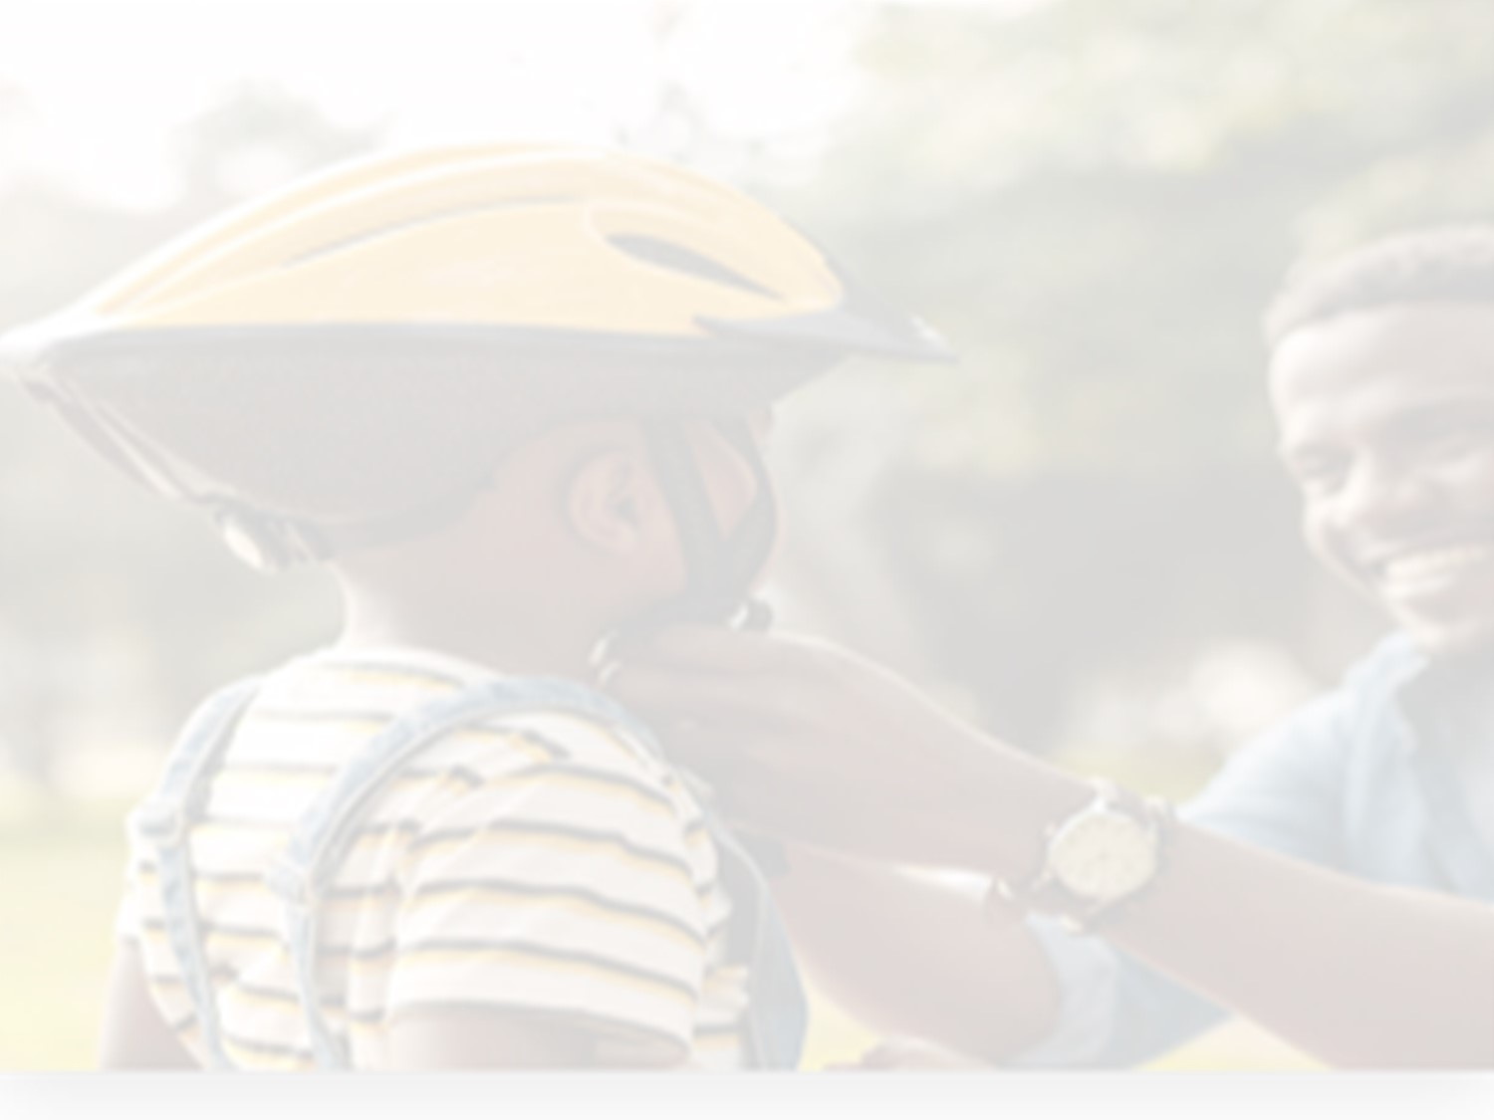
Abstract
Motorcycle accidents have been rapidly growing through the years in many countries. In India more than 37 million people use two wheelers. Therefore, it is necessary to develop a system for automatic detection of helmet wearing for road safety. So, by this system it detects the rider helmet and if the rider with helmet, then it opens the gate and allows the biker for fuel filling if not it wont allow the bike for fueling. By this system we can avoid the motorcycle accidents and if we keep helmet as a mandatory for rider while filling fuel at petroleum bunks then every biker will maintain and wearied with helmet using this caution, we can save the lives and they start following the traffic and road safety rules.
This Application can be implemented in real-time using a Webcam or a CCTV as input.
CMRCET-CSE

Slide 4

Introduction
The two-wheeler is a common means of transportation in practically every country. However, due to the lack of safeguards, there is a significant danger associated. The wearing of a helmet by bike riders can significantly lessen the risks they face on the road. Because of the importance of wearing a helmet, governments have made it as a crime to ride a bike without helmet. So we need a system here to detect the helmet to overcome with the accidents and to make people to follow the traffic and road safety rules if they were getting on to the roads.
CMRCET-CSE
Notes:
CMRCET-CSE

Slide 5

Literature Review
E-CHALLAN AUTOMATION
E-Challan is that foolproof regulated system.
E-Challan is an online E-governance system to facilitate the traffic managers to manage the traffic violation as well as for the drivers to manage the penalties.
E-Challan provides a wide range of support needed for managing and monitoring traffic penalties
IOT BASED TOLL COLLECTION SYSTEM USING RFID (Radio Frequency Identification)
Toll plazas were manually operated prior.
Two persons are responsible for unlocking and unlocking the gate, while two others are responsible for receiving and storing money and other valuables.
CMRCET-CSE

Slide 6

Existing Works
The Existing system monitors the traffic violations primarily through CCTV recordings, where the traffic police have to look into the frame where the traffic violation is happening, zoom into the license plate in case rider is not wearing helmet. But this requires lot of manpower and time as the traffic violations frequently and the number of people using motorcycles is increasing day-by-day.
Hence efficient and feasible techniques have to be created to overcome these problems. Manual surveillance of traffic using a person on roads is an existing methodology.
CMRCET-CSE

Slide 7

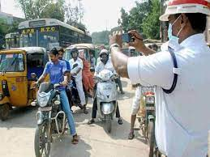
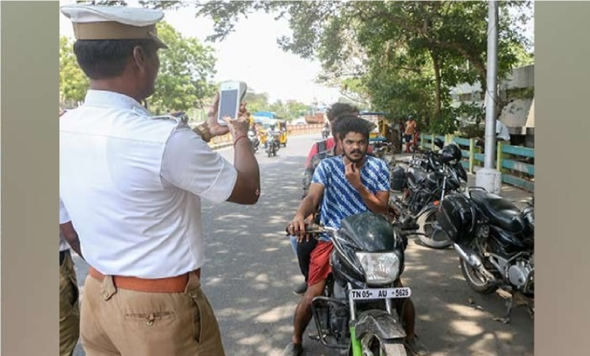
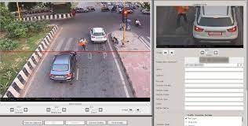
Results of Existing System
E-Challan generation system
Traffic Cops To Go After Vehicles Without Helmet
E-Challan Processing Through The Nearest Police Control Room
CMRCET-CSE

Slide 8
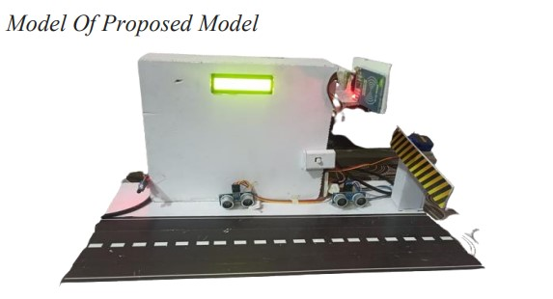
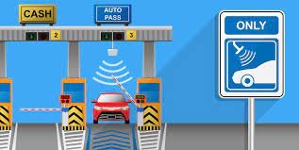
Cont..
IOT based Toll Plaza using RFID
Model for IOT Based Model of TOLL Collection System
.
Toll Pass Detection of Fast tag & Allowing to Pass Vehicle through it
CMRCET-CSE

Slide 9


Proposed Method Description
Implementing the helmet detection at fuel bunks using the webcam or cctv using python iot models here we are detecting the helmet of the rider who are at petroleum pump here it detects and then allows the rider to fill fuel
So, here firstly it detects helmet if helmet detected successfully then a gate will rised and allows the rider to fill fuel.
Here we using technologies Tensorflow, YOLO3 (You Only Look Once), CNN(Convolutional Neural Network), openCv using Python.
CMRCET-CSE

Slide 10

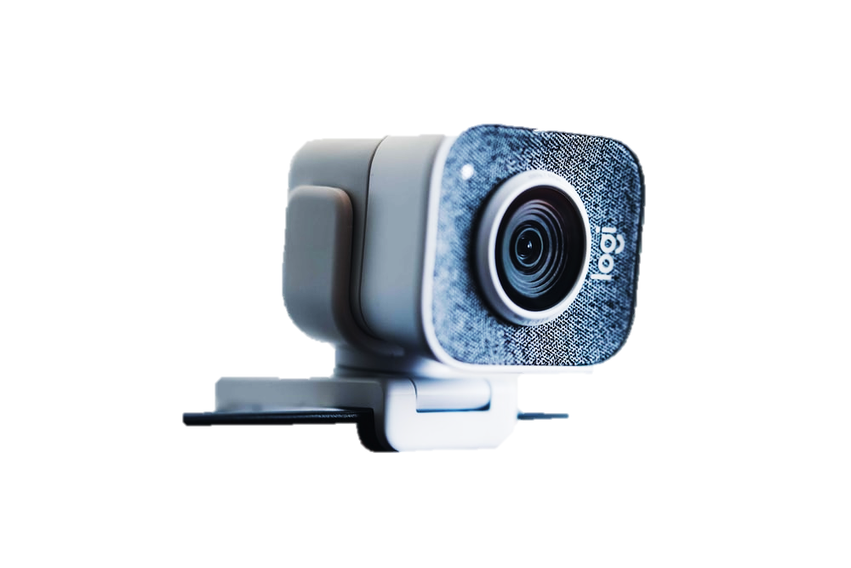

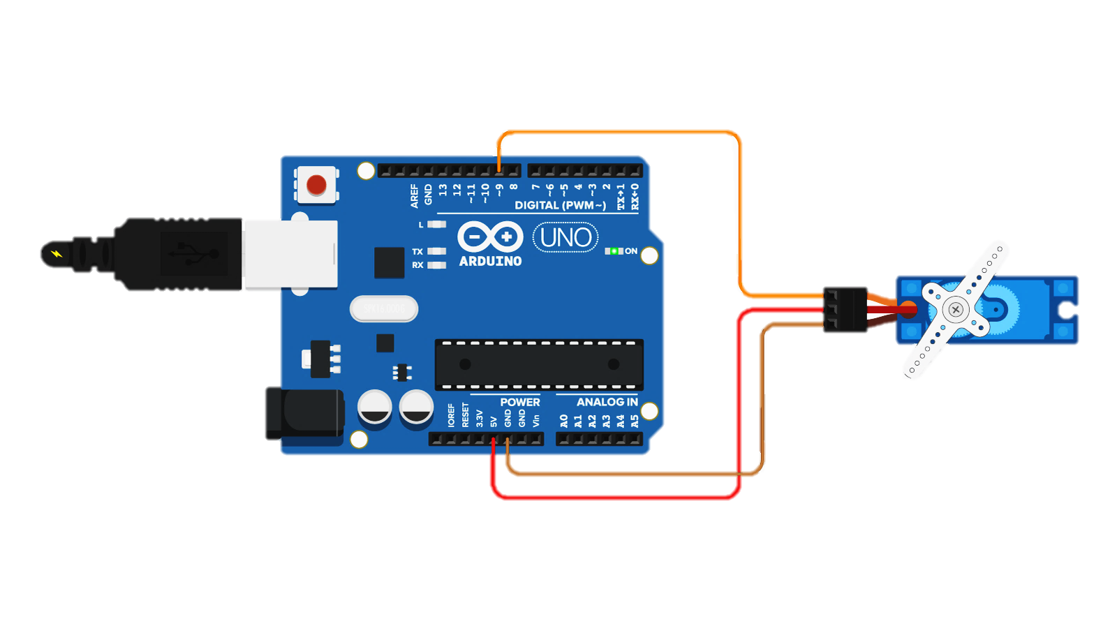
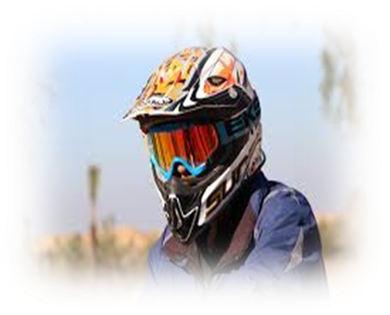
Proposed System
WEBCAM
INPUT
OUTPUT
SYSTEM
It process instructions like detection and then it instruct to Arduino to do task.
C
A
P
T
U
R
E
S
ARDIUNO WITH SERVO MOTOR
Block Diagram
RIDER WITH HELMET
CMRCET-CSE

Slide 11
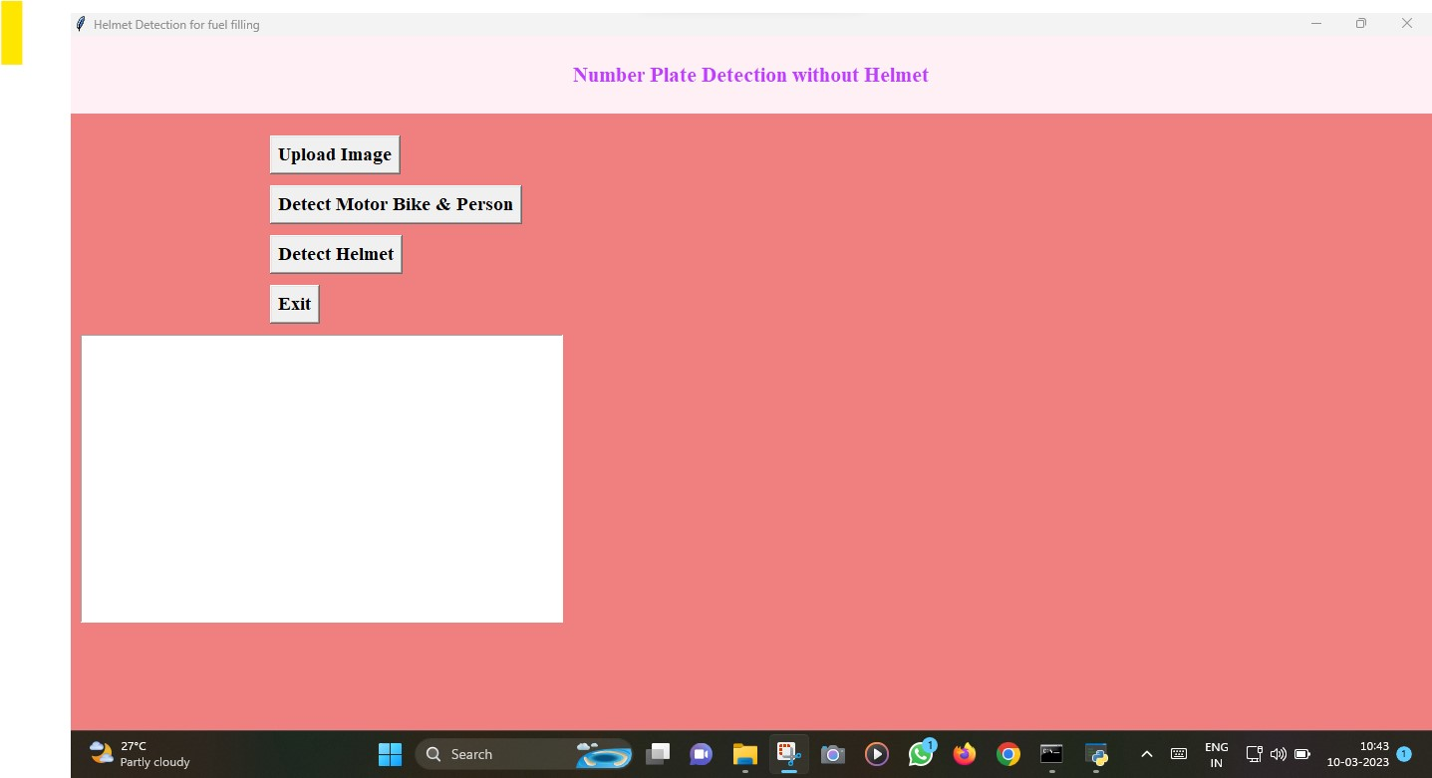
Implementation
Home Page
CMRCET-CSE

Slide 12
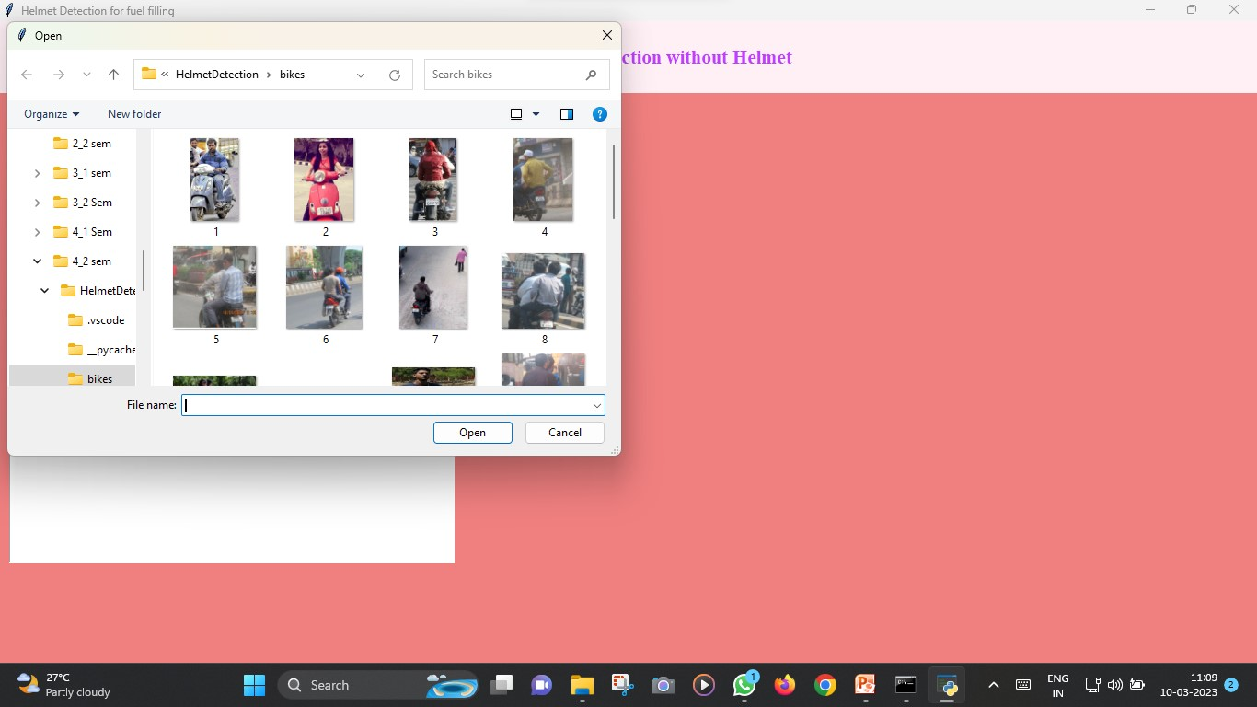
Cont…
Image Uploading
CMRCET

Slide 13
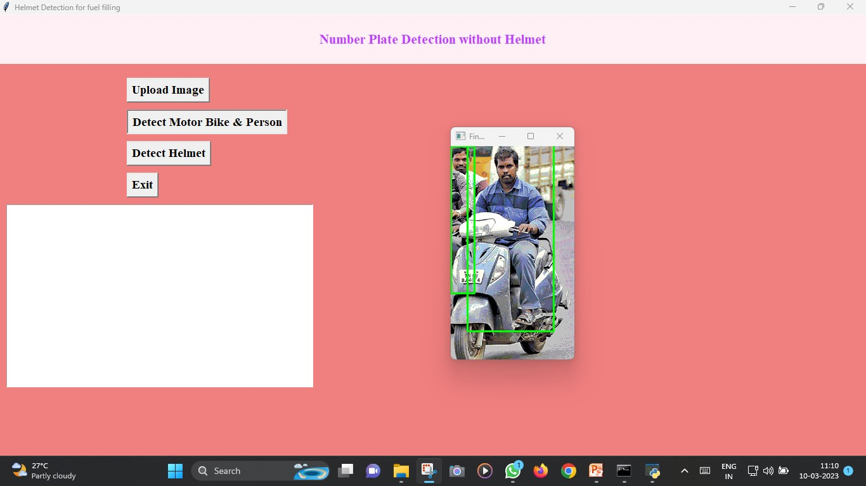
Cont..
Detection Motor Bike & Person
CMRCET

Slide 14
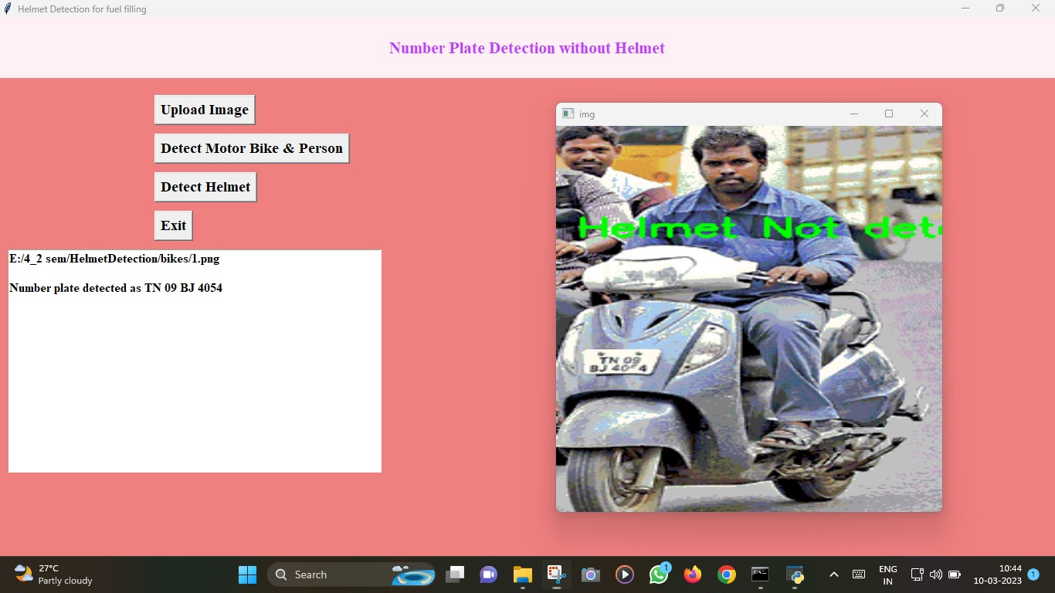
Cont..
Without Helmet Detection
CMRCET

Slide 15
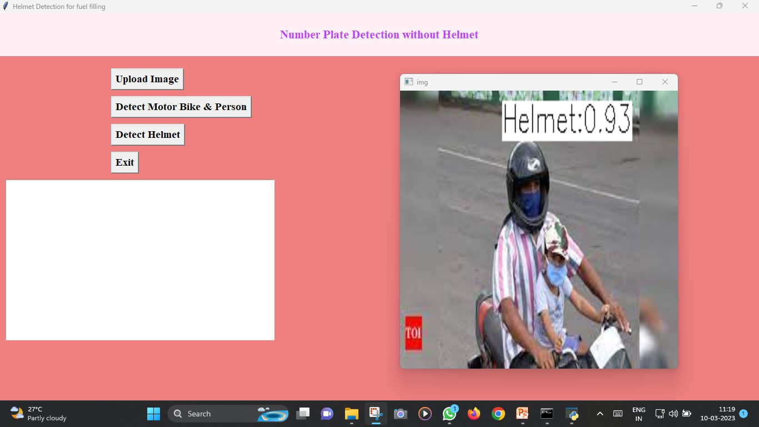
Cont..
With Helmet Detection
CMRCET

Slide 16

The proposed system aims to prevent motorcycle accidents and also reduce the fatality of accidents. Machine learning algorithm and IOT based model has high accuracy and automatically detects the helmet and mediately it give response like lifting the gates for fueling.
This system makes a habit to wear a helmet among motorcycle riders. The helmet would make a motorcycle journey more protected and safer.
CMRCET-CSE

Slide 17

References
Github link of the project report
  https://github.com/srikanthcsk/CMRCET-05
CMRCET-CSE

Slide 18


